Slide 1

BHARAT INSTITUTE OF ENGINEERING AND TECHNOLOGY Ibrahimpatnam – 501 510, Hyderabad
Department of Computer Science and Engineering
Minor Project
Project Title:
Analysis using Machine Learning for Hoax URLs
Final Review
February 2022
Submitted by:
P. PAVAN KALYAN -18E11A0578
O.VENKATESH -18E11A0577
SYED MUQTHAR ALI-18E11A0584
B. UDAY KIRAN -18E11A0551
G. SURYA PRAKASH -19E15A0508
Supervisor:
Dr. K. Thirupal Reddy

Slide 2
Table of Contents:
Abstract
Requirements
Introduction
Existing System
Design Methodology
Sample Code
Conclusion
References

Slide 3
Abstract:
The internet is full of websites that are either fake, fraudulent or a scam.
The evolution of the internet has brought with it a number of extremely convenient advances in the way we shop, bank, and interact with the world around us.
A large number of people buy things online and pay for them using various online payment platforms. Several websites require users to enter sensitive data in order to authenticate.
Some phishing websites make use of this information for various purposes.
A web application is developed to identify the URL type.

Slide 4
System Requirements:
ARM 64 bit processor
4GB RAM
16GB ROM.

Slide 5
Software Requirements:
Flask
Python
Machine Learning.

Slide 6
Introduction:
The input URL is taken from the user.
Each part of the URL is analysed with the predefined values.
Classification is used to classify that the URL is legitimate or phishing.

Slide 7
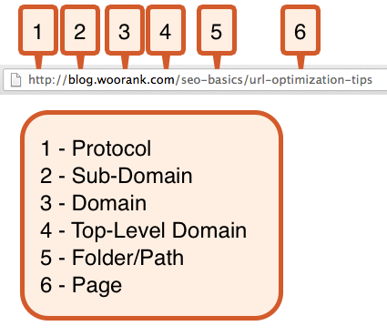
Definition of a URL

Slide 8
Existing system:
By using Logistic Regression algorithm for detection of Phishing URLs the prediction accuracy is around 94 percentage.
A new algorithm is tested for the improvement in the prediction.

Slide 9
Proposed System:
The URL detection is done by using Support Vector Machine(SVM) and also with the help of Random Forest Classifier(RFC).
By using these algorithms there is a slight change in the predicted results which is improved to more accuracy.

Slide 10
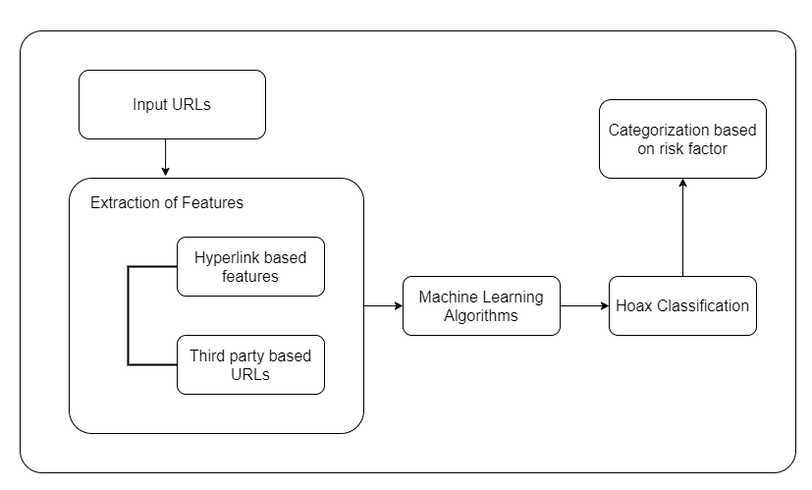
Design Methodology:

Slide 11
Input URLs:
Any example URL is provided as a input.
b) Extraction of URLs:
The input URL is extracted for further analysis.
c) Hyperlink based features:
The URL is verified for hyperlink type.

Slide 12
d) Machine Learning Algorithms:
Here Support Vector Machine algorithm is used to predict more accurately than compared with the previous methods.
e) Hoax Classification:
The classification is done after analyzing the structure of the URL and displayed in the result.

Slide 13
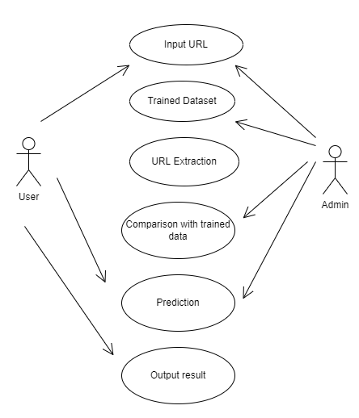
UML Diagrams
Use Case Diagram:

Slide 14
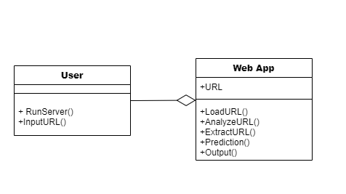
Class Diagram:

Slide 15
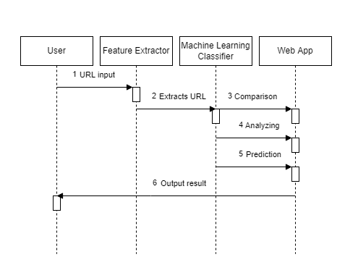
Sequence Diagram:

Slide 16
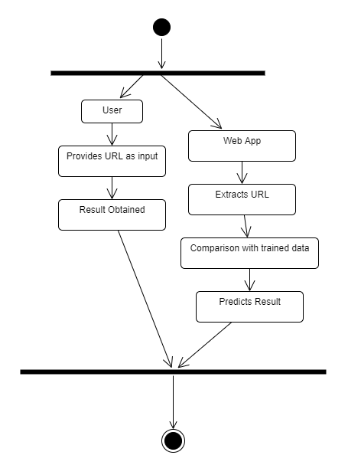
Activity Diagram:

Slide 17
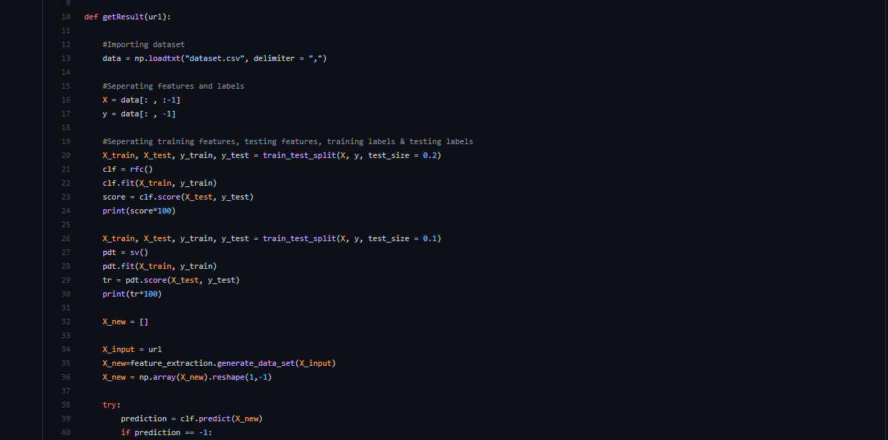
Sample Code

Slide 18
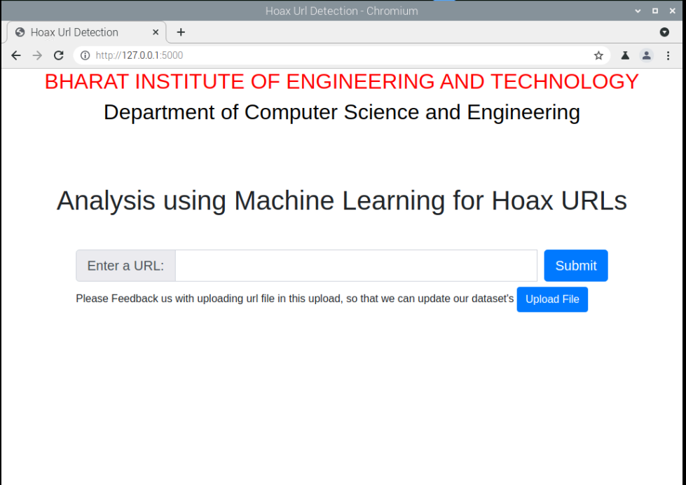
Results:

Slide 19
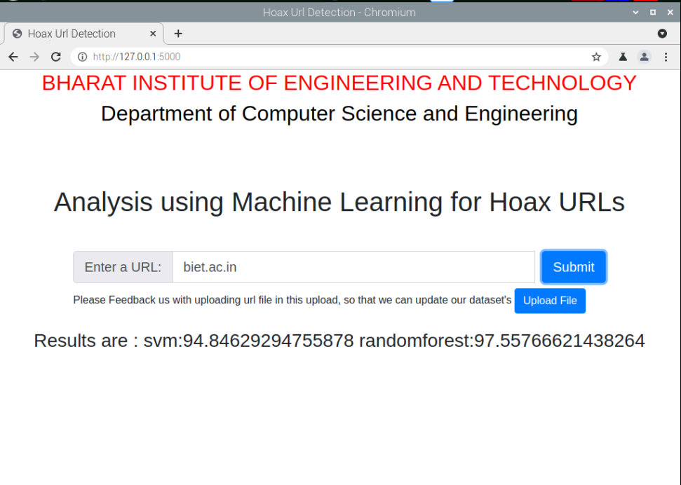
Results:

Slide 20
Conclusion:
Using Machine Learning domain we had created a detection method which
provides efficient result.

Slide 21
References:
[1] https://ieeexplore.ieee.org/document/9396014.://ieeexplore.ieee.org/document/9396014.
[2] https://www.analyticsvidhya.com/blog/2017.09/understanding-support-vector-machine-example-code/.

Slide 22
Thank you..

